Slide 1

Smart Librarian
ONN WEI CHENG YANG JIE SHEN
NIRAV JANAK PARIKH
https://ychef.files.bbci.co.uk/976x549/p03gg1lc.jpg

Slide 2
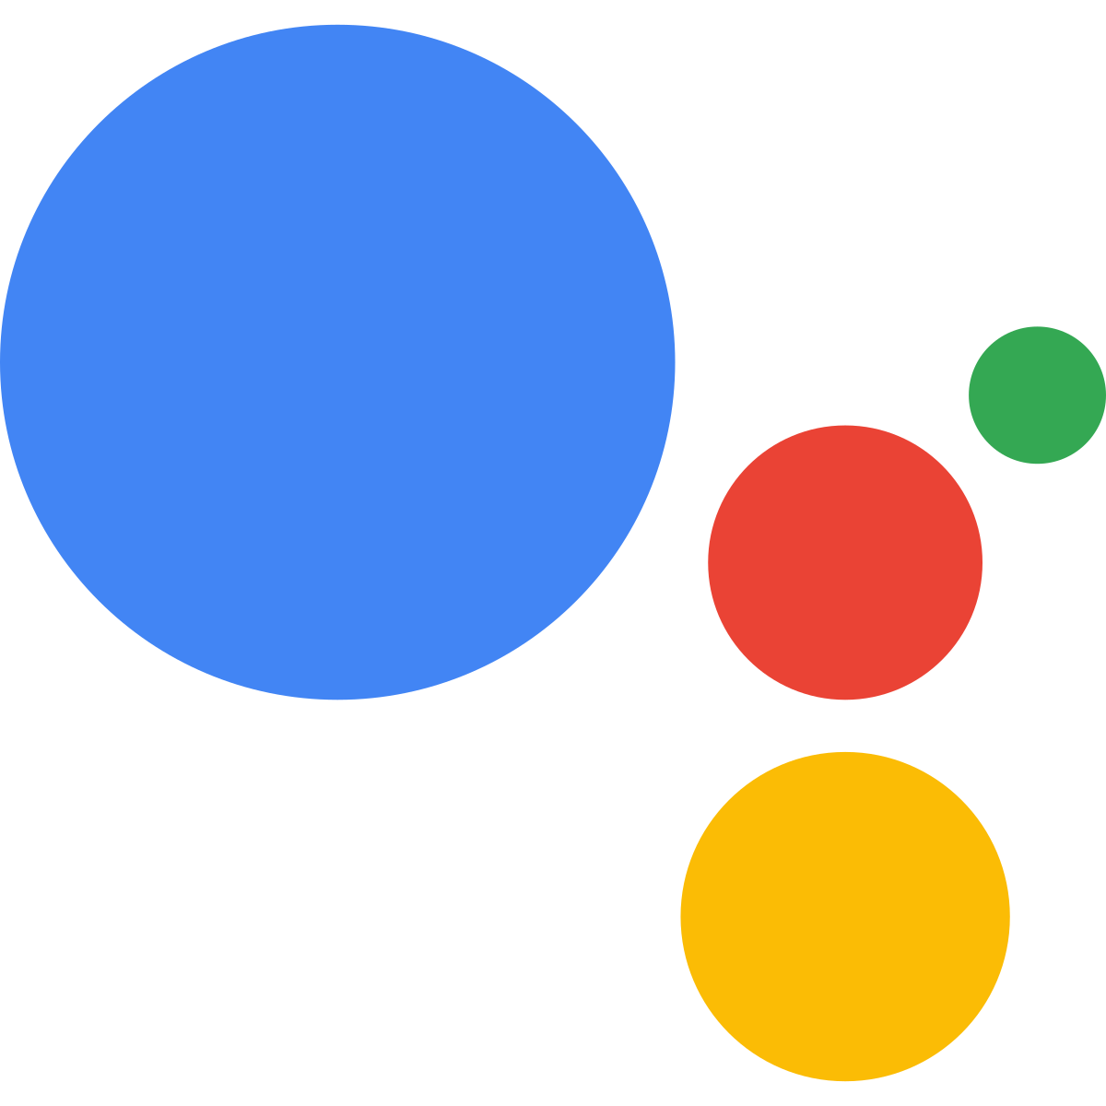
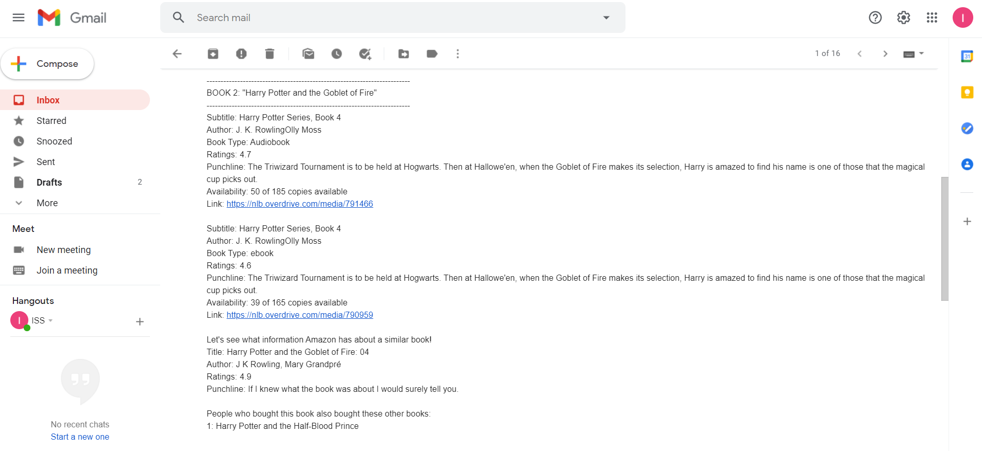
Value Proposition
Hello! I am your friendly neighbourhood Librarian. What book would you like to borrow from NLB?
I would like to borrow Harry Potter and the Goblet of Fire.
-------------------------------------------------------------------------
BOOK 1: "Harry Potter and the Goblet of Fire"
-------------------------------------------------------------------------
Subtitle: Harry Potter Series, Book 4
Author: J. K. RowlingOlly Moss
Book Type: ebook
Ratings: 4.6
Punchline: The Triwizard Tournament is to be held at Hogwarts. Then at Hallowe'en, when the Goblet of Fire makes its selection, Harry is amazed to find his name is one of those that the magical cup picks out.
Availability: 39 of 165 copies available
Link: https://nlb.overdrive.com/media/790959
Let's see what information Amazon has about a similar book!
Title: Harry Potter and the Goblet of Fire: 04
Author: J K Rowling, Mary Grandpré
Ratings: 4.9
Punchline: If I knew what the book was about I would surely tell you.
People who bought this book also bought these other books:
1: Harry Potter and the Half-Blood Prince
Would you like to enquire about another book? Current book list: Harry Potter and the Goblet of Fire
No
Ok! I will send you an email on the ratings and availability of the books that you have enquired. Thank you and Goodbye!
The availability, ratings, punchline and recommendations of selected books will be shared via email.

Slide 3
System Architecture
Conversational UI
Intent from user
NLB Availability Checker
Amazon Recommendation System
Intelligent Title Matcher and Abstract Summary
Email for User

Slide 4



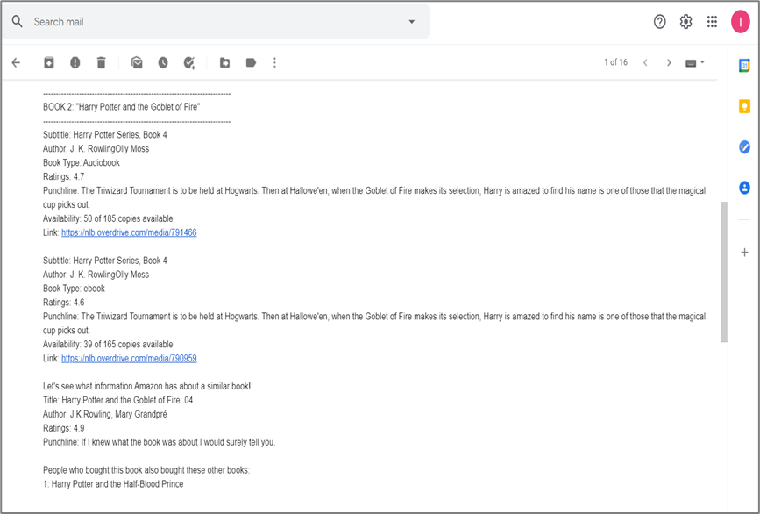
Technical Explanation of Usecases
Conversational UI & Email
NLB Availability Checker & Amazon Recommendation Systems
Intelligent Title Matcher & Abstract Summarizer
Powered by Google Assistant & Dialogflow
Qwerty
Powered by UI Tag
Powered by Bert

Slide 5
Converstional UI & Email

Slide 6
NLB Availability Checker & Amazon Recommendation System

Slide 7
Intelligent Title Matcher & Abstract Summarizer

